Slide 1
Impact of renewable-regulation on companies
Czech-Austrian Winter and Summer School 2011

Slide 2
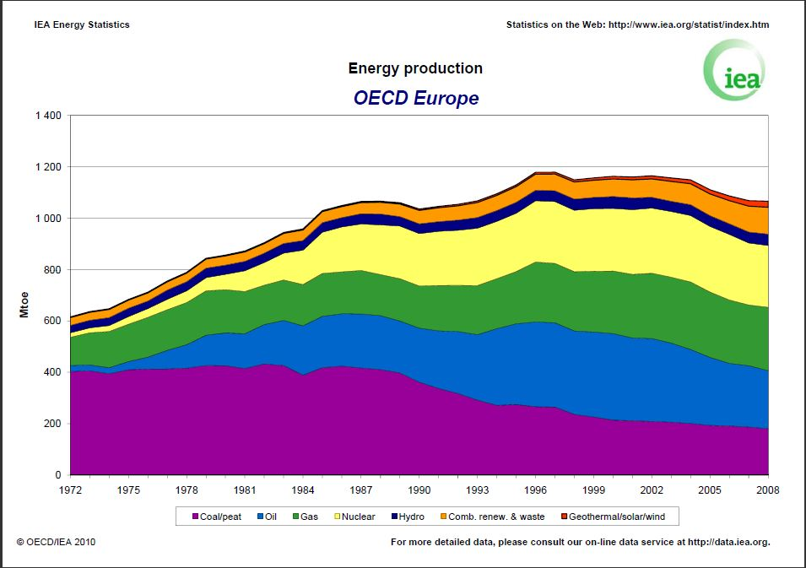
Abstract

Slide 3
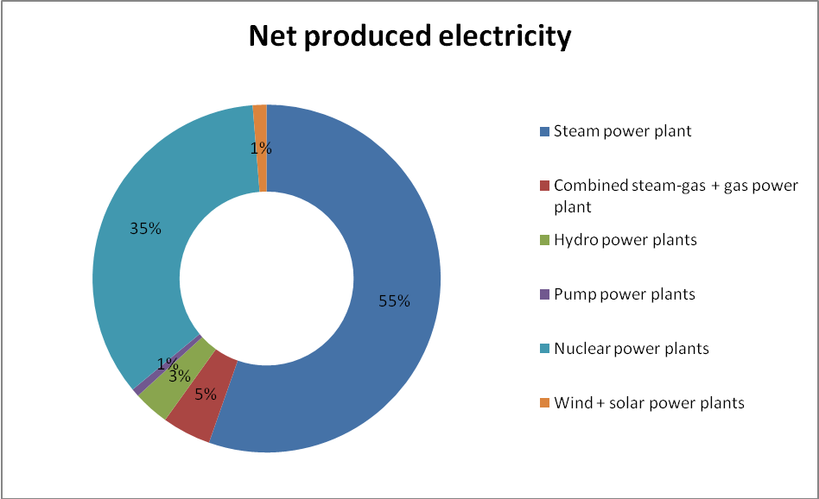
Energy-Mix (Czech Republic)

Slide 4
Energy-Mix (Austria)
TYP | Produced el [GWh] (netto) | %
Run-over-River plant | 29.865 | 43,3
Thermal power plant | 23.382 | 33,9
Storage power plant | 13.105 | 19
Wind, PV, Geothermic | 2.000 | 2,9
Other | 621 | 0,9

Slide 5
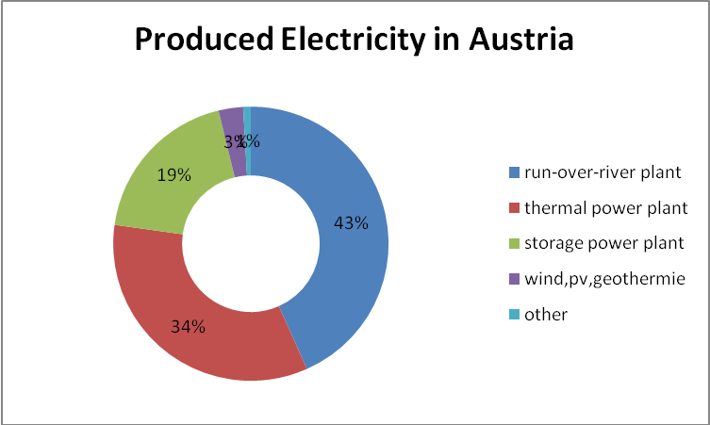
Energy Mix (Austria)

Slide 6
The Start of the RES-Regulation
 | Target 2020 [%] | Assumption [%] | deviation
Austria | 34 | 34,2 | 0,2
Belgium | 13 | 13 | 0
Bulgaria | 16 | 18,8 | 2,8
Cyprus | 13 | 13 | 0
Czech rep. | 13 | 13,5 | 0,5
Denmark | 30 | 30,4 | 0,4
Estonia | 25 | 25 | 0
Finland | 38 | 38 | 0
France | 23 | 23 | 0
Germany | 18 | 19,6 | 1,6
Greece | 18 | 20,2 | 2,2
Hungary | 13 | 14,7 | 1,7
Ireland | 16 | 16 | 0
Italy | 17 | 16,1 | -0,9
Latvia | 40 | 40 | 0
Lithuania | 23 | 24 | 1
Luxembourg | 11 | 8,9 | 2,1
Malta | 10 | 10,2 | 0,2
Netherlands | 14 | 14,5 | 0,5
Poland | 15 | 15,5 | 0,5
Portugal | 31 | 31 | 0
Romania | 24 | 24 | 0
Slovakia | 14 | 15,3 | 1,3
Slovenia | 25 | 25,3 | 0,3
Spain | 20 | 22,7 | 2,7
Sweden | 49 | 50,2 | 1,2
Great Britain | 15 | 15 | 0

Slide 7
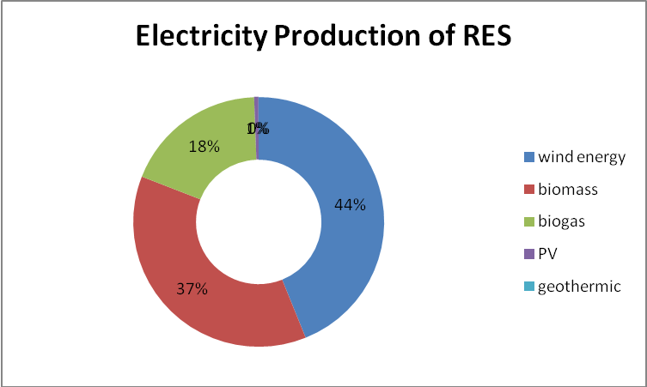
The target for Austria
By 2020 produce 34% of the energy out of RES
Since 2002 regulation of RES implemented into law (Ökostromgesetz)
2011 the market price for green energy is 60.39 EUR/MWh

Slide 8
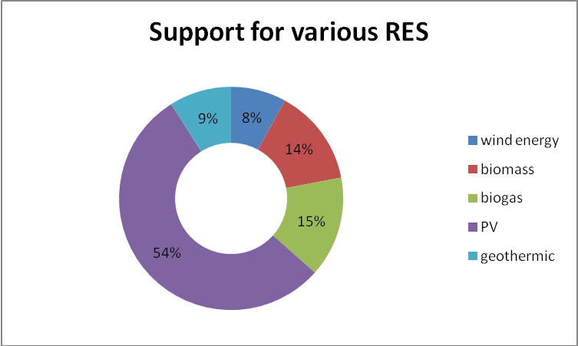
The target for Austria
A big part in our law is the payback for feeding-in energy from renewable resources
Mostly for: Wind power and biomass
Highest payback for PV-Panels (high investments!)
Payback vary a lot, because of RES volatility

Slide 9
Impact on electricity prices
Renewables support (17,6EUR/MWh in CZ)
Decrease of electricity futures price (0-3,5EUR/MWh)
Increase of distribution costs
Increase of transmission costs
Increase of supporting services costs
Higher investments

Slide 10
Impact on electricity prices
Base-Load electricity price change depending on production from PV

Slide 11
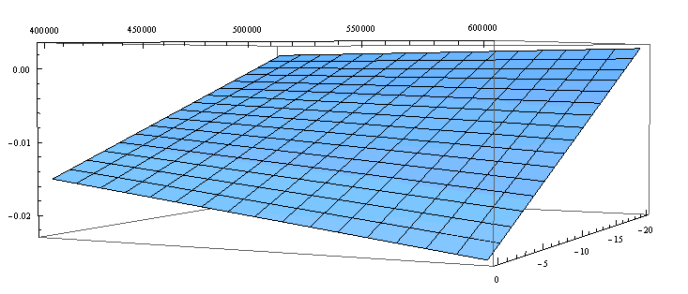
Case: Skoda
Cars manufacturer
Annual electricity consumption (2010): 479.000 MWh
Corporate tax rate: 19%
EAT (2010): 376mil EUR

Slide 12
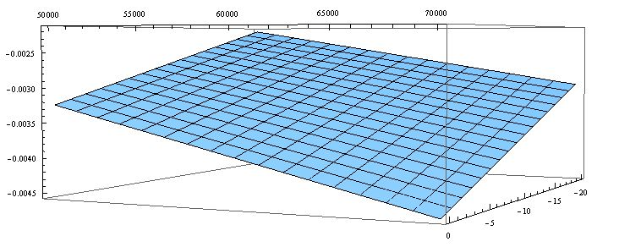
Case: VOEST ALPINE
Steal-producer and a global partner for the automotive and energy industry
Annual electricity consumption (2010): 64.687,25 MWh
Corporate tax rate: 25%
EAT (2010): 700mil EUR

Slide 13
Conclusion
Because of the RES-Regulation energy prices rise
It has an effect on companies, but there are much more factores (e.g. German‘s exit from nuclear, Japan‘s disaster)
Companies can never rely on stable prices → have to hedge against electricity price changes
Austria is ahead against Czech in amount of electricity produced from RES (natural conditions, law, higher energy prices) → general lower impact!

Slide 14
THANKS FOR YOUR ATTENTION!

